Slide 1
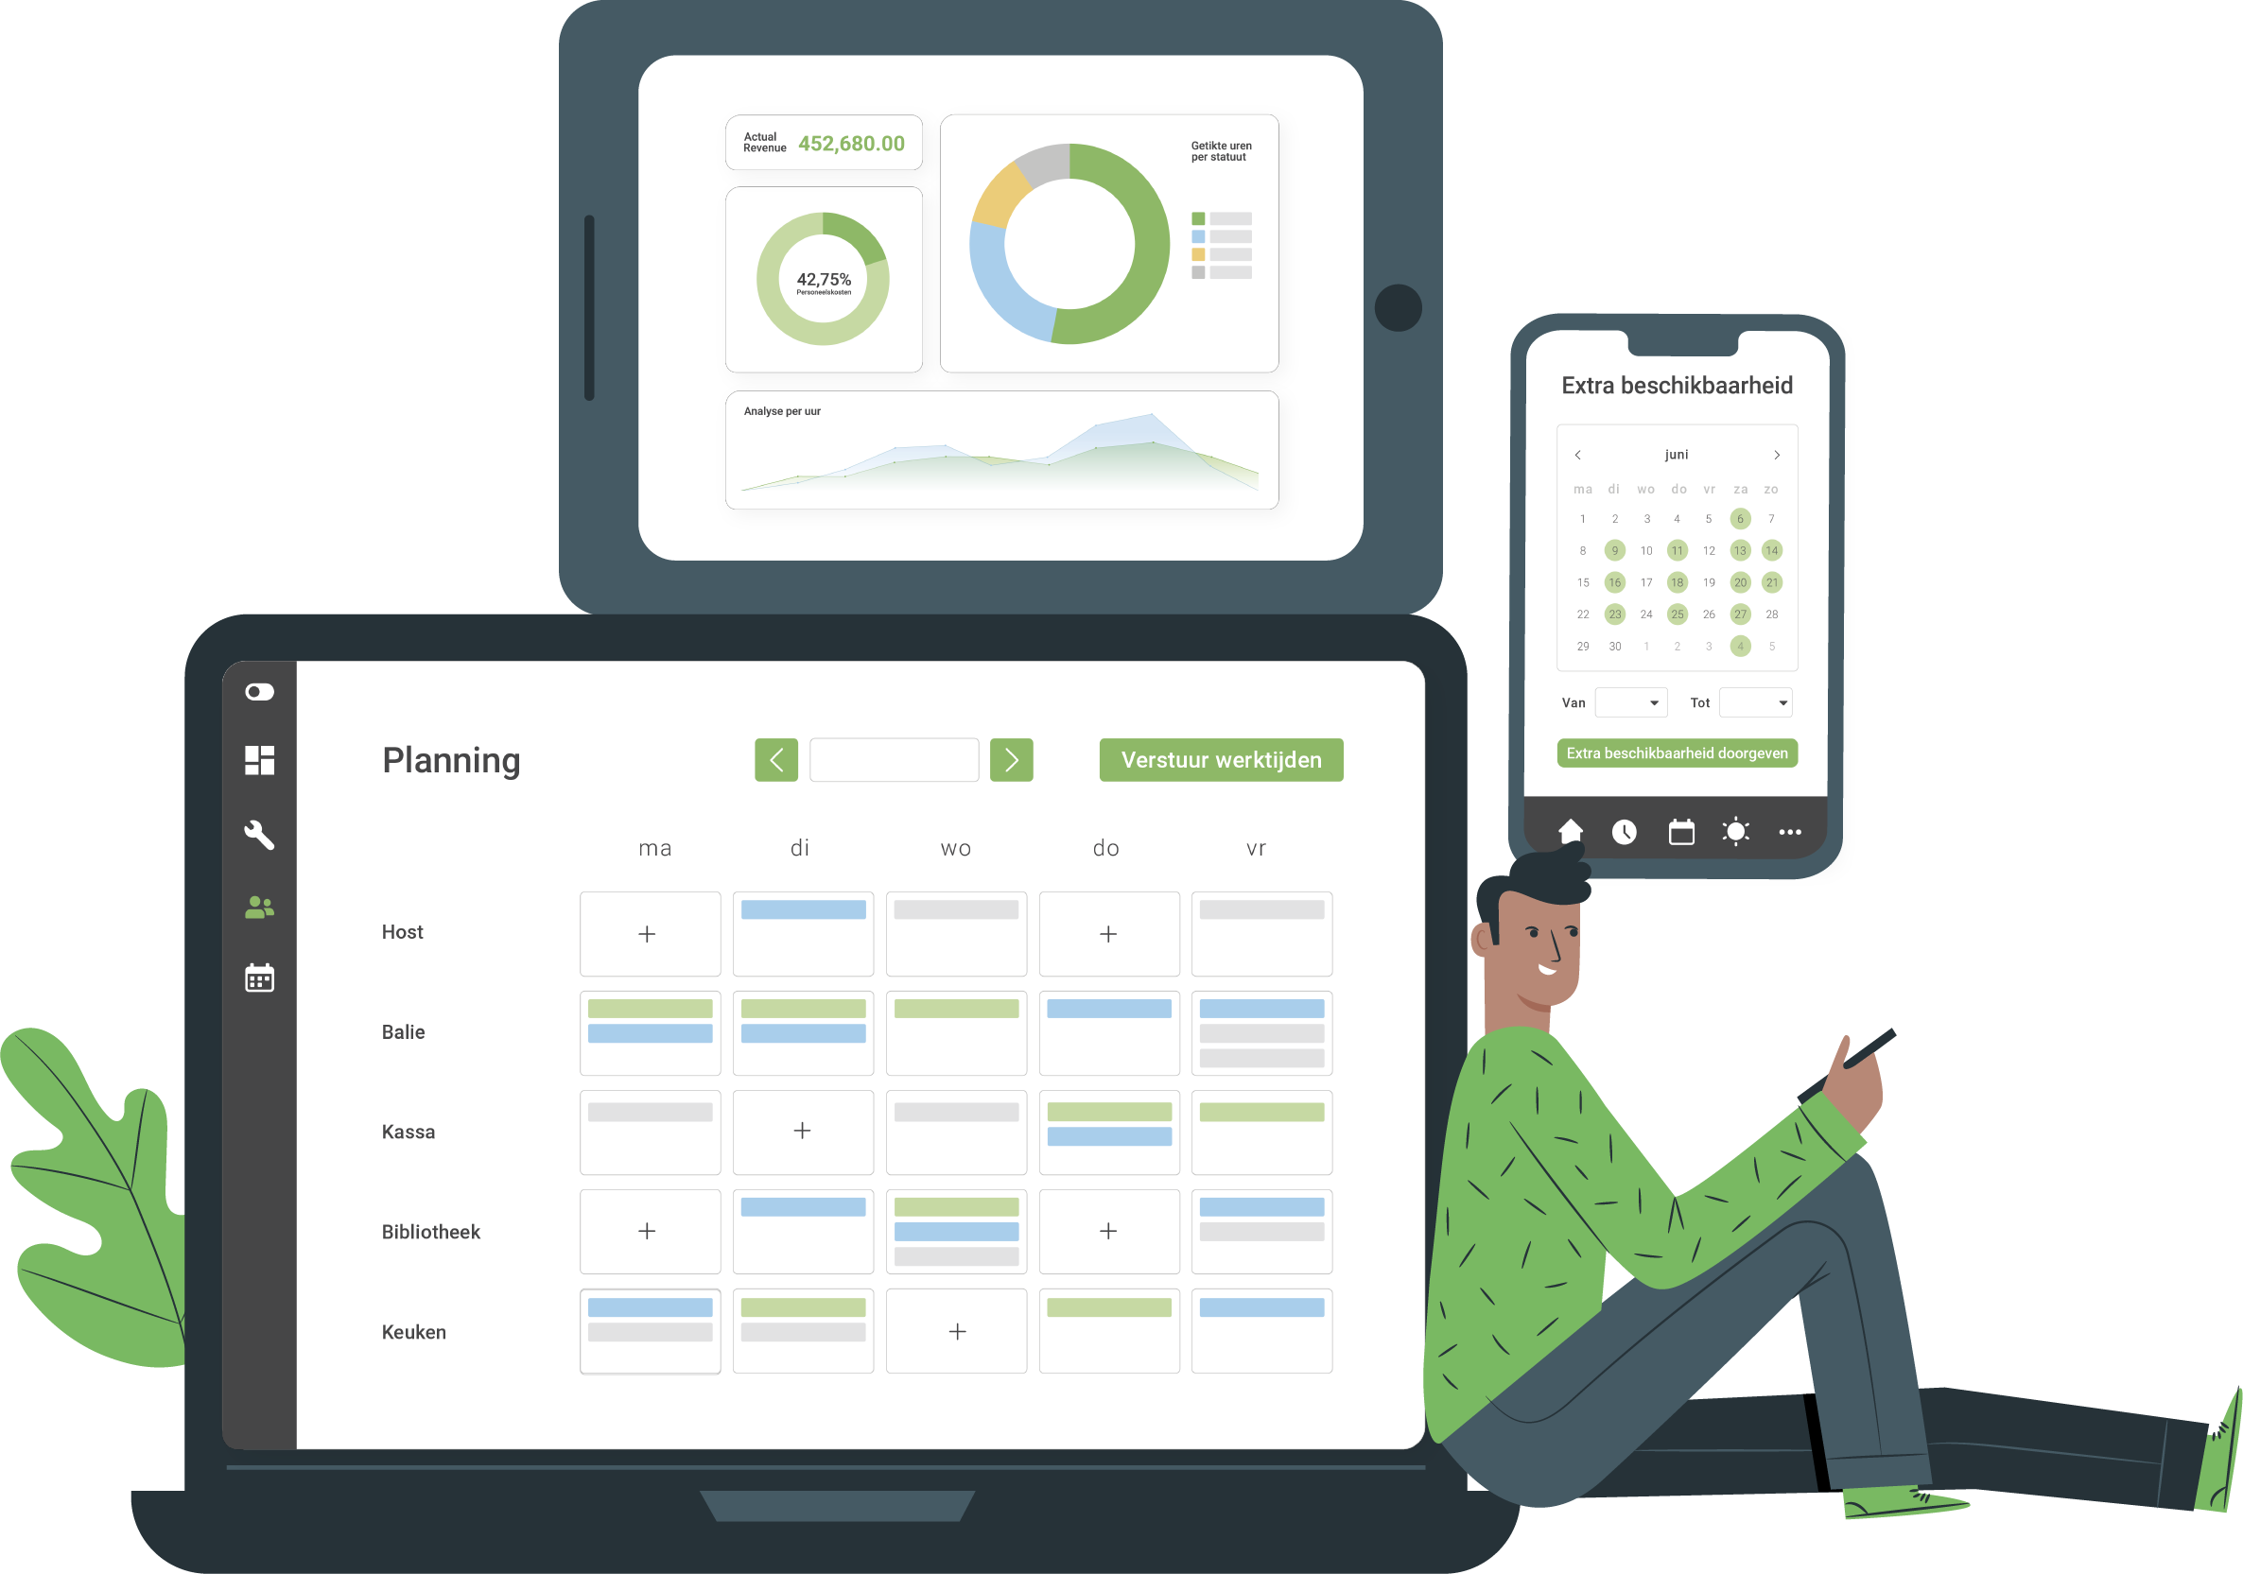
Automate your
employee planning
Including Dimona, time registration, payroll integration & reporting
Notes:
NGE: de mockup van planning veranderen door de nieuwe mockup van Anouk

Slide 2

What we do

Slide 3



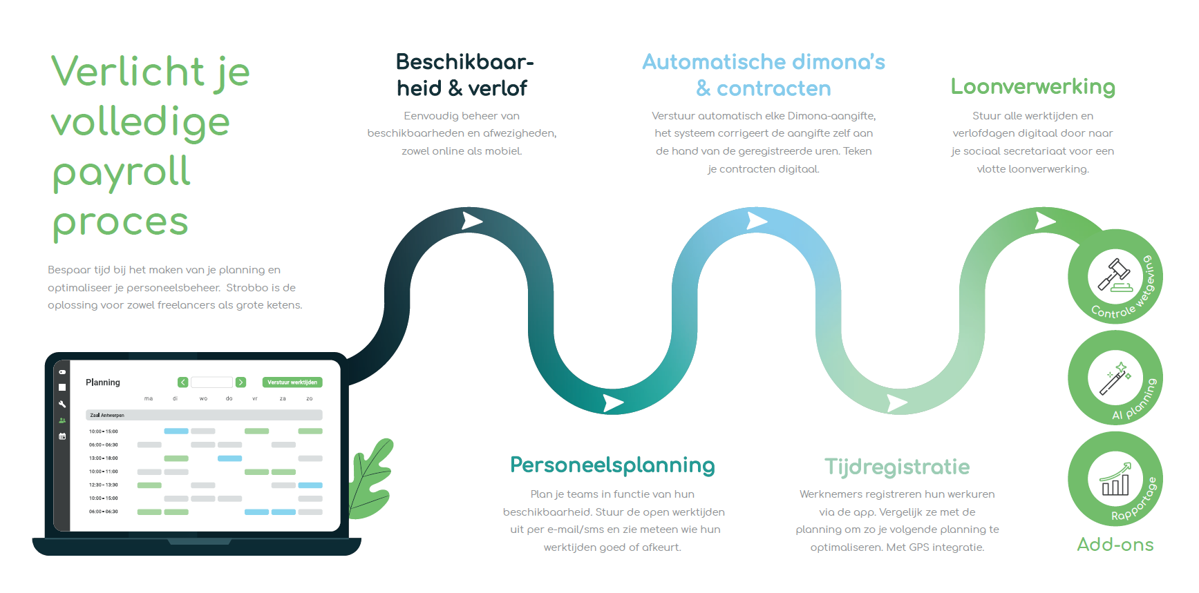


Automate your flexible staff planning
Staff
planning
Digital
Time registration
Reporting
Automated dimona & contracts
Payroll integration
Notes:
NGE: hier moet de nieuwe screenshot in komen

Slide 4
























1300 customers
In 4 countries

Slide 5
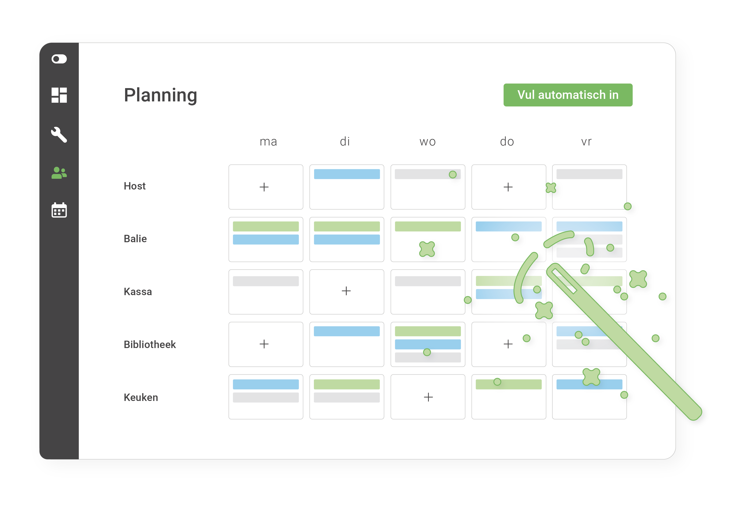





Interactive planning
Employees can sign up for open shifts that have not yet been assigned by the scheduler.
Employees can request shift changes that may or may not need to be approved by the supervisor.
All of this is done via our iPhone and Android app.

Slide 6

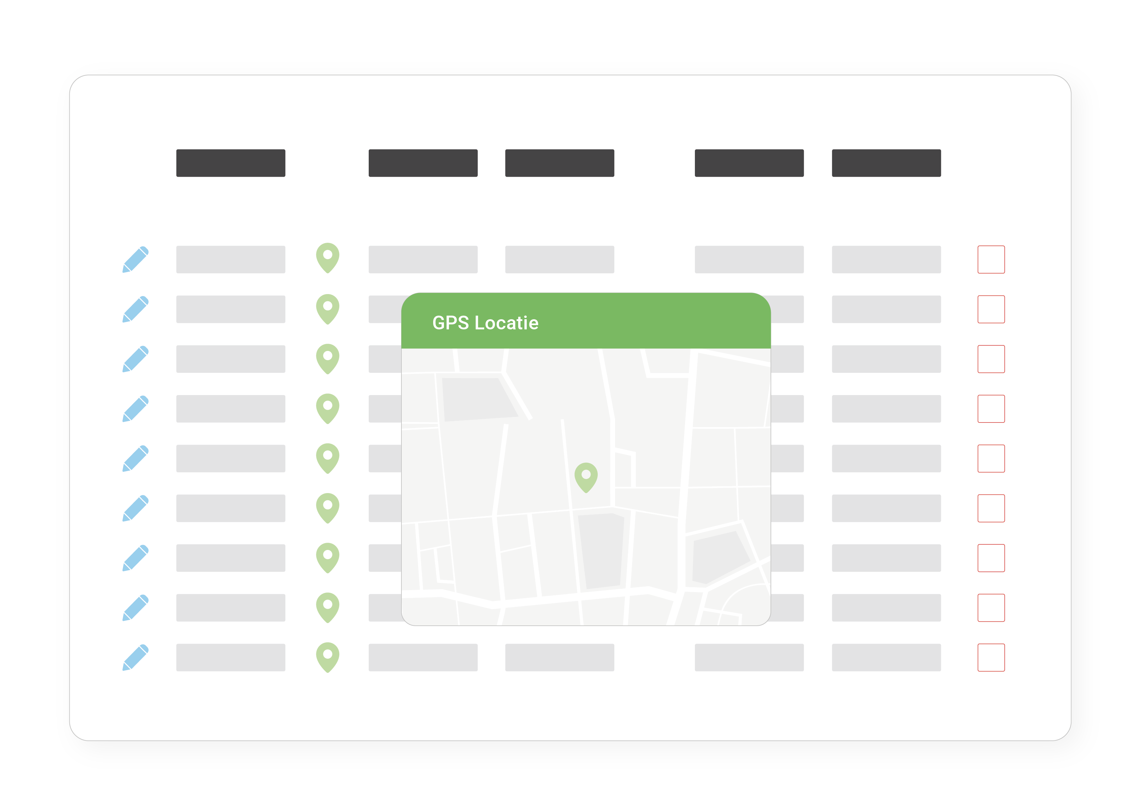
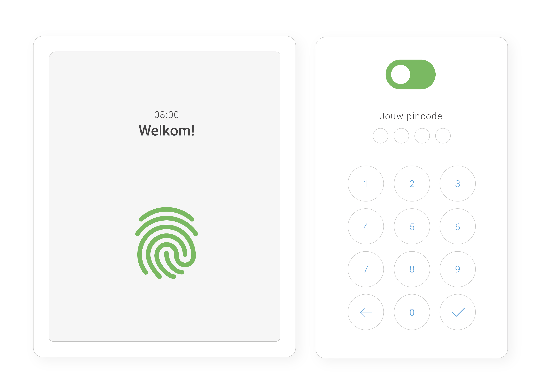

Time registration
GPS or fixed
Any device
Calculation of wages + link payroll office / interim

Slide 7
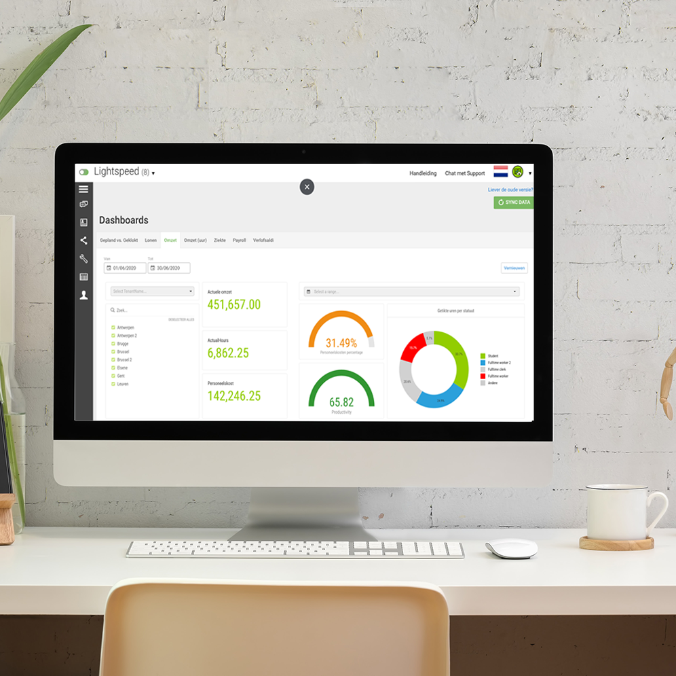
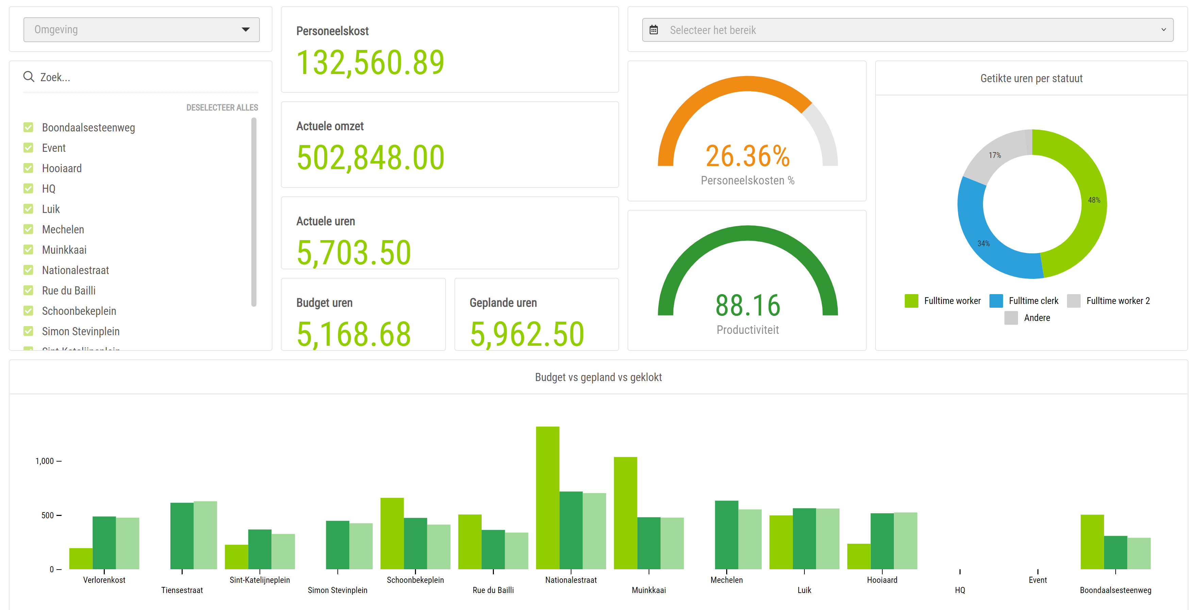



Focus on Planning & Profitability
Planning based on turnover
Focus on profitability
Direct reporting for the planner & management

Slide 8
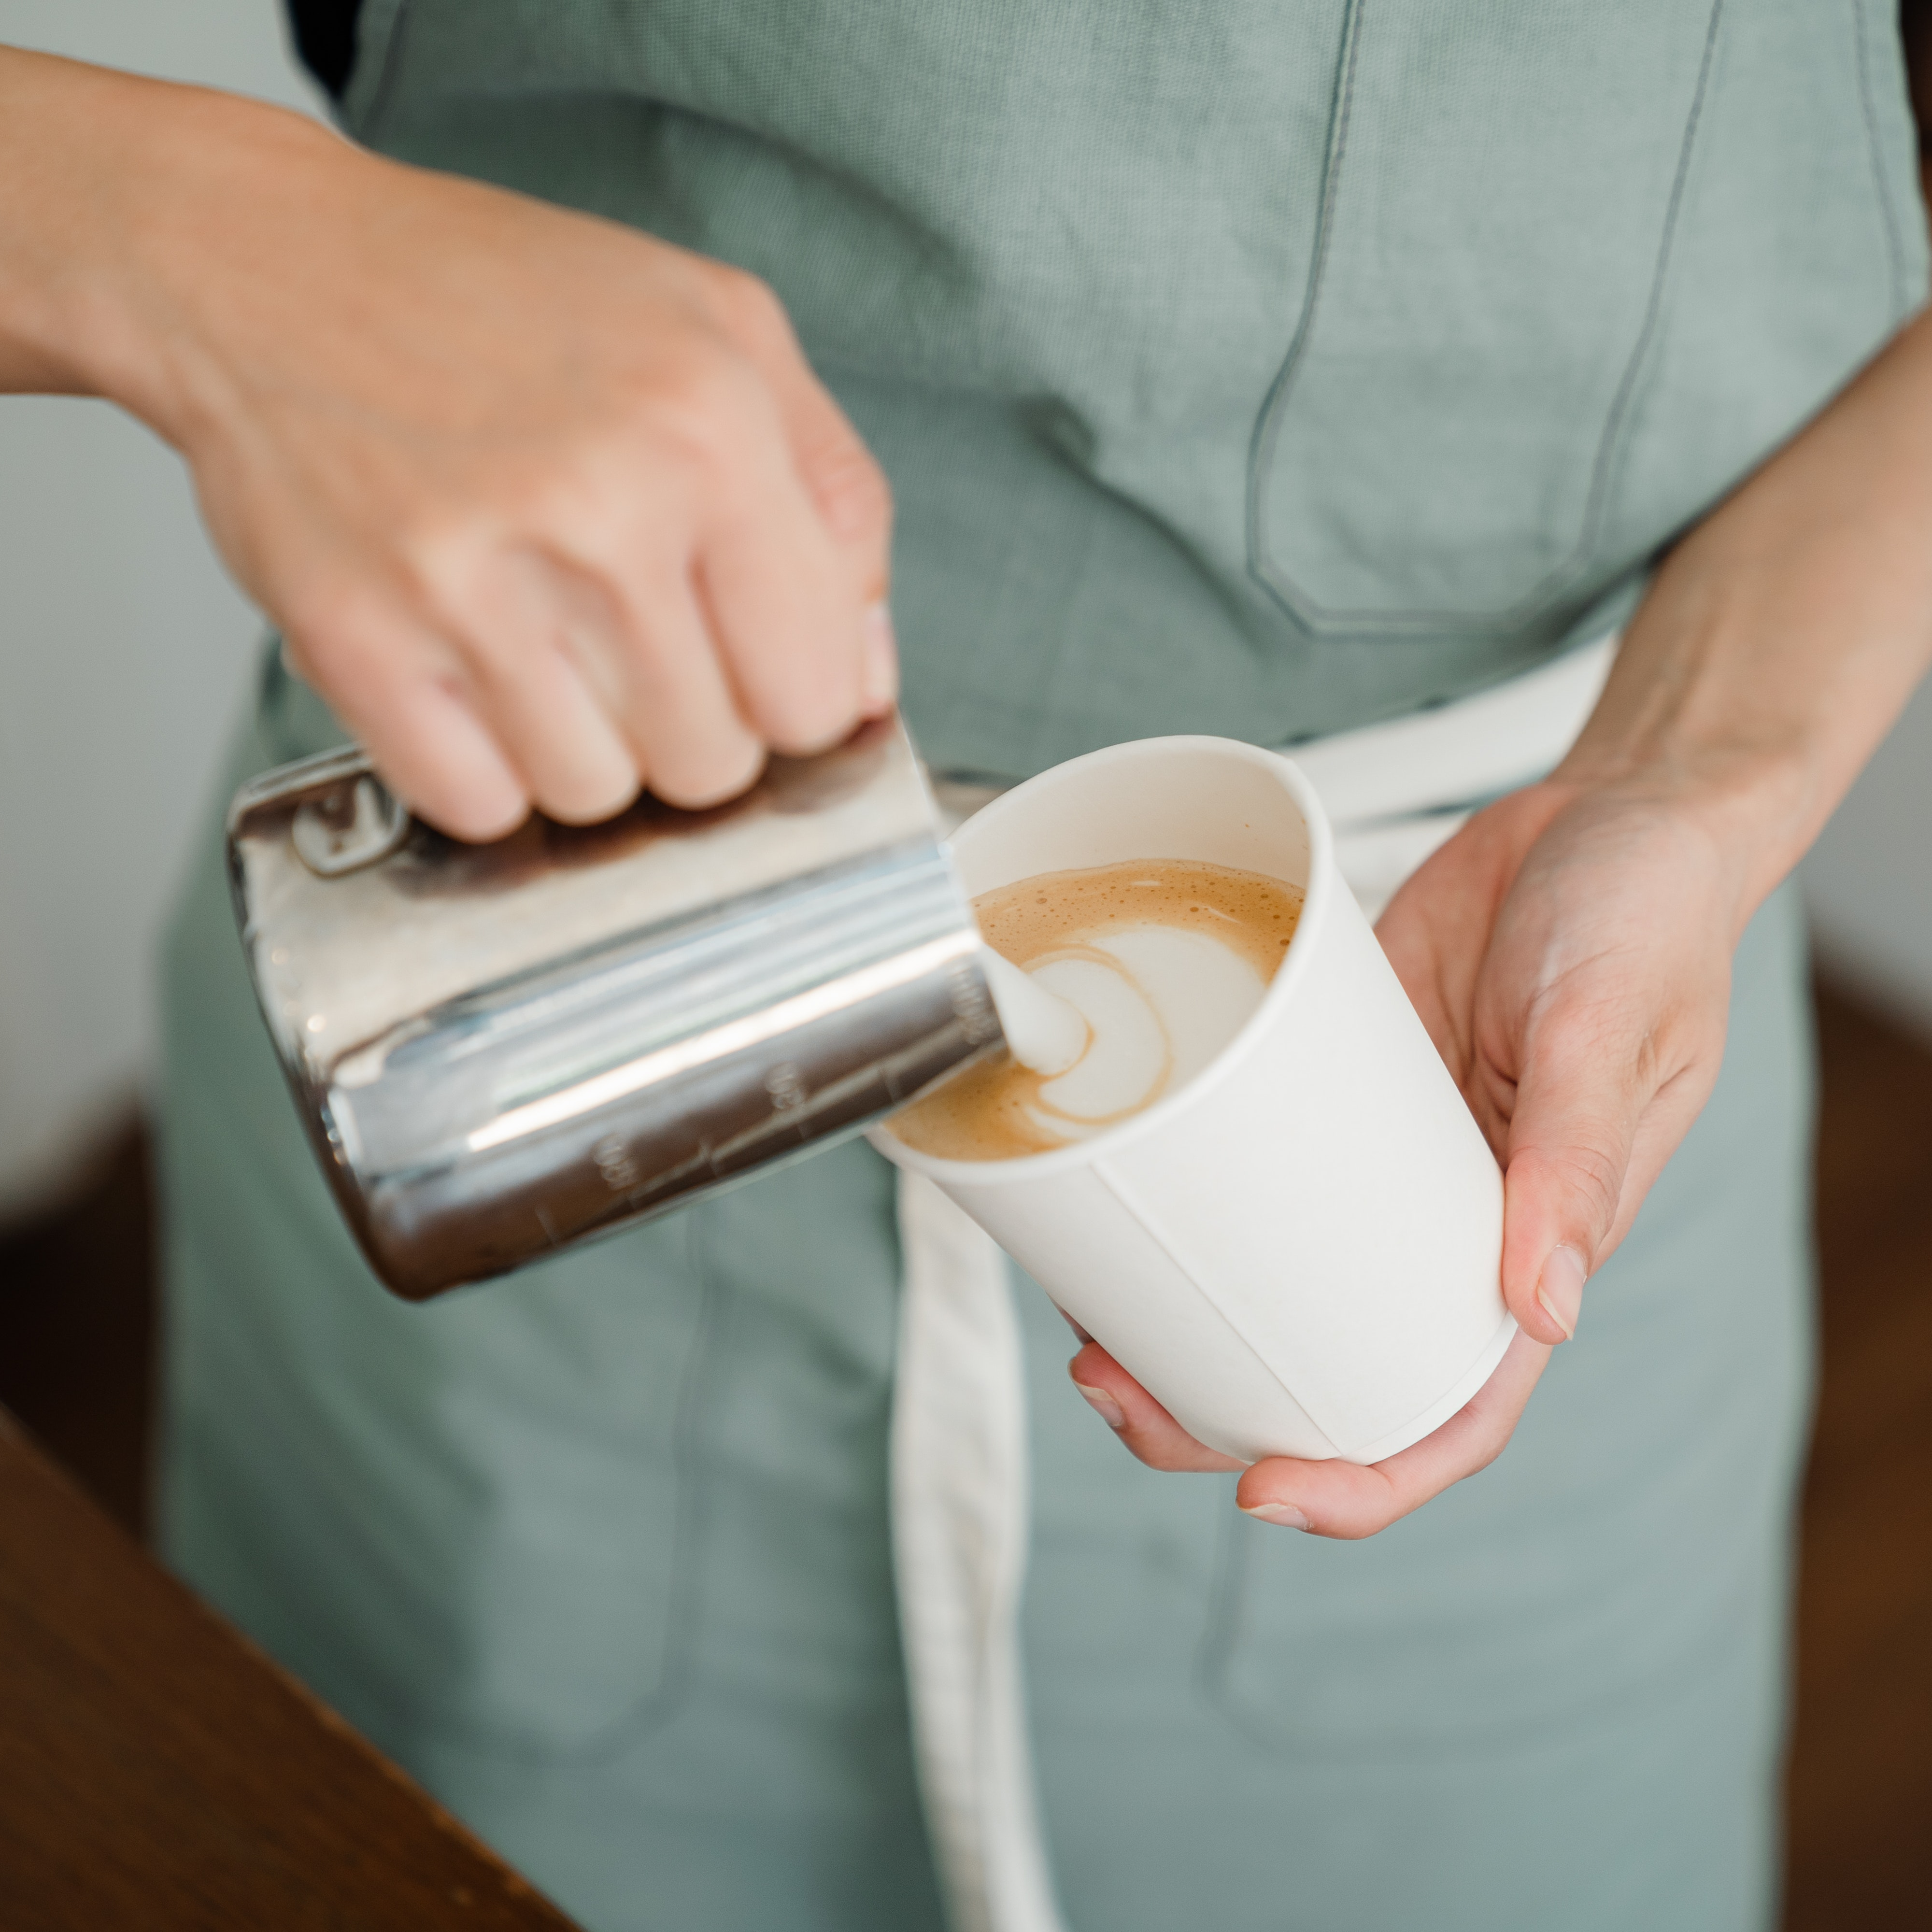
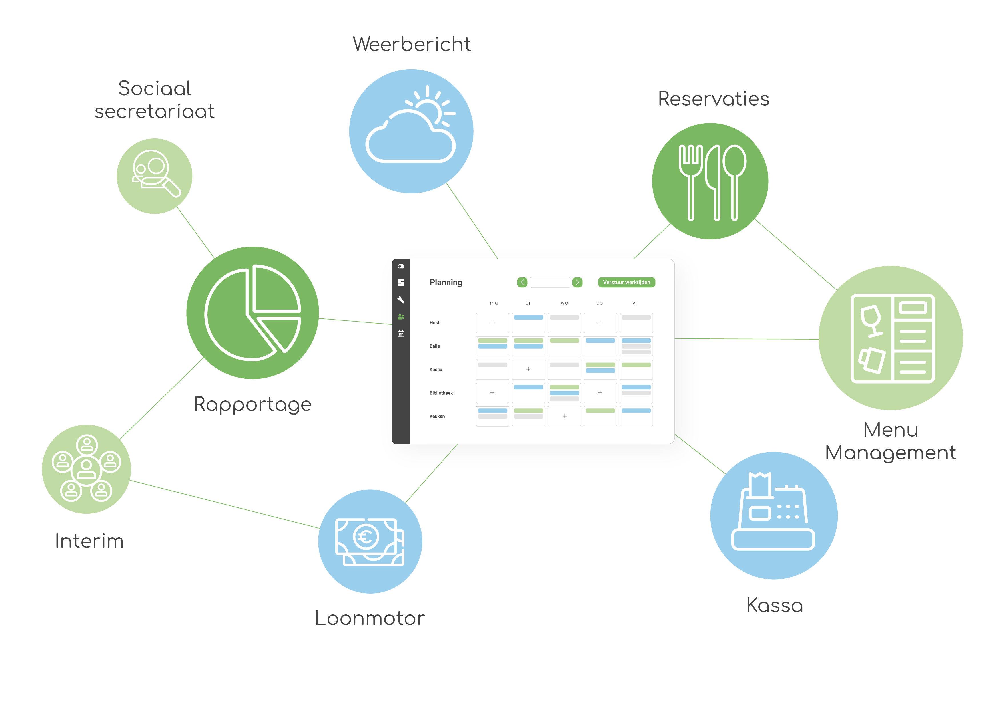
Strobbo central for all HR needs
Weather forecast
Payroll provider
Reservations
Reporting
Menu management
Interim
Payroll engine
Cash register

Slide 9
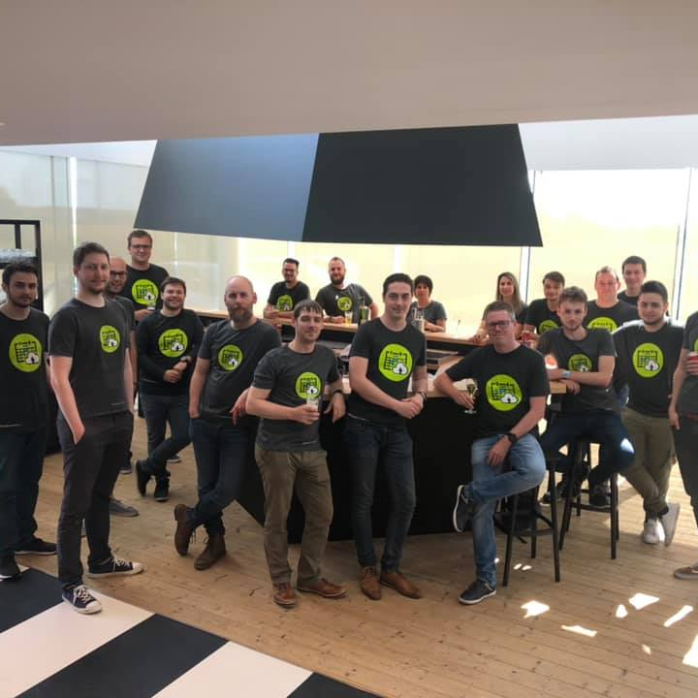
About Strobbo

Slide 10

1300
2020
902
2019
Agile start-up
2017
447
2018
80
2016
180
2017
Dec 2016
Start sale
Nov 2017
Winner Innovation price
Aug 2018
Acquisition by Protime
Dec 2019
Marketleader Belgium flexible work scheduling
June 2019
Rebranding + International growth

Slide 11
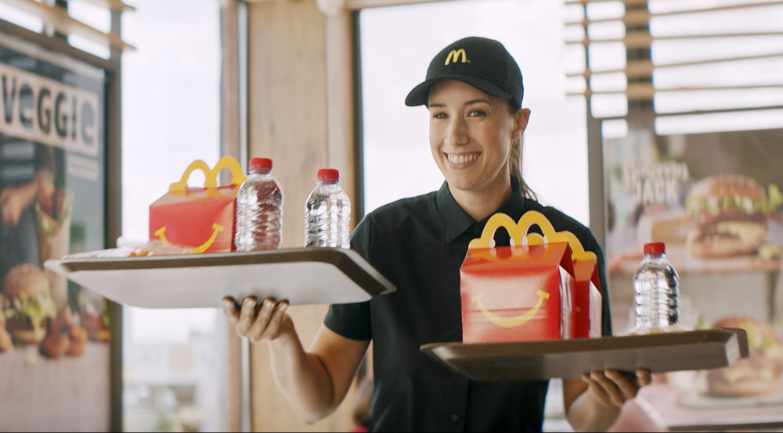
Since 2019
Larger customers!
Notes:
Nieuwe titel slide: overgang naar grotere klanten

Slide 12


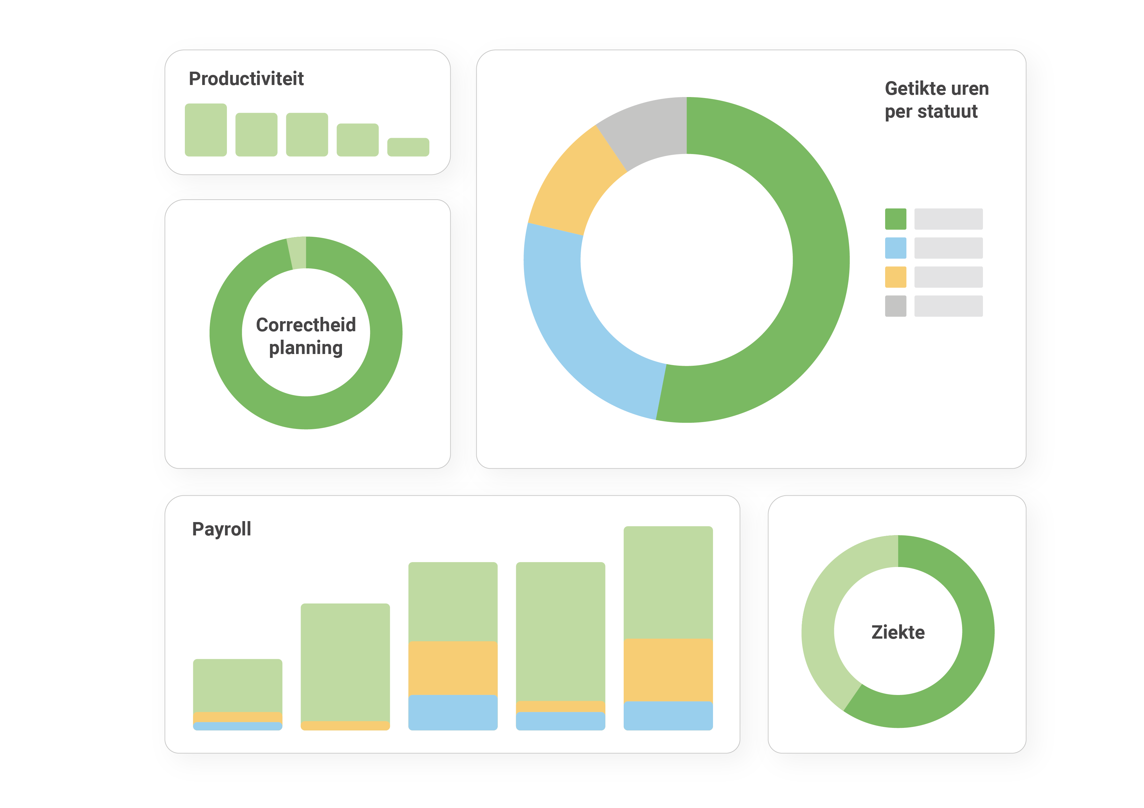




Data driven planning
Availability
Turnover & costs
Weather
AI
History / Request
Reservations

Slide 13



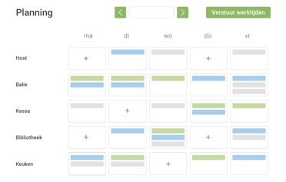

Self scheduling

Slide 14

“I process payroll 3 days faster than before and gain at least 4 more days with administration… I couldn’t be happier!”
Less manual
More automation
Including
Dimona
time registration
payroll integration
Reporting including
Dimona
time registration
payroll integration
Reporting
…
Ehssane Belmekki, Ellis Gourmet Burger
Notes:
Elke maand 3 dagen gewonnen met loonverwerking en 4 dagen met administratie… Ik ben blij.” Ehssane Belmekki, Ellis Gourmet Burger

Slide 15







Large enterprises & Franchises

Slide 16










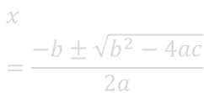

More complex planning
=
More complex payroll processing
$${\left(x+a\right)}^{n}=\sum_{k=0}^{n}{\left({n \atop k}\right)x^{k}a^{n−k}}$$
$$x=\frac{−b±\sqrt{b^{2}−4ac}}{2a}$$

Slide 17


Belgium: 1250
Netherlands: 75
Luxemburg: 5
France: 5
Member of the
SD Worx group

Slide 18

Strobbo
@Noordlink
Louis Pasteurstraat 21
3920 Lommel
België

